Slide 1
ERASMUS
Committee Meeting
1 November 2019
2013
2016
Notes:
21:47
AGÜ Gençlik Fabrikası
Gençler için gençlerle birlikte daha iyi bir topluma...
Türkiye’de bir ilk olan Gençlik Fabrikası:
• gençleri eğiten,
• yaratıcı ve girişimci olmaya teşvik eden,
• gençlere yaşama dair beceriler kazandıran,
• uluslararası vizyon katan,
• gençlerin toplumsal hayata katılımını sağlayıp bir arada öğrenmenin ve üretmenin keyfine vardıran,
• ulusal ve uluslararası boyutta faaliyet gösteren öğrenen odaklı bir yapıdır.

Slide 2
Agenda Items
Presentations of applicants
Discussion on the selection of staff for the new term project
Discussion on the next plans and meetings
2013
2016

Slide 3
Staff Mobilty@AGU
Department | Teaching | Training
Architecture | 3 | 0
Business Administration | 7 | 0
Civil Engineering | 1 | 0
Computer Engineering | 2 | 3
Electrical and Electronics | 2 | 4
Industrial Engineering | 0 | 1
Mechanical Engineering | 2 | 1
Economics | 5 | 2
International Office | 0 | 5
Educational Sciences | 1 | 3
School Of Languages | 0 | 4
Political Science and Public Administration | 0 | 1
2013
2016

Slide 4
Staff Mobilty@AGU 2018-2020
 | Number | Dates
Teaching Mobility | 11+ 3 left from previous project until 2020 Total: 14 | Until 2021
Training Mobility | 3 | Until 2021
2013
2016

Slide 5
New Applications
Name | Department | Experience | Country | Institution | Dates | Mobility Type
Hakan Gover | School of Languages | 8 years | Germany | University of Duisburg-Essen | 25-28 November 2019 | Training
Eyüp Doğan | Economics | 5 years | Germany | ISM International School of Management | March 2020 | Teaching
2013
2016

Slide 6
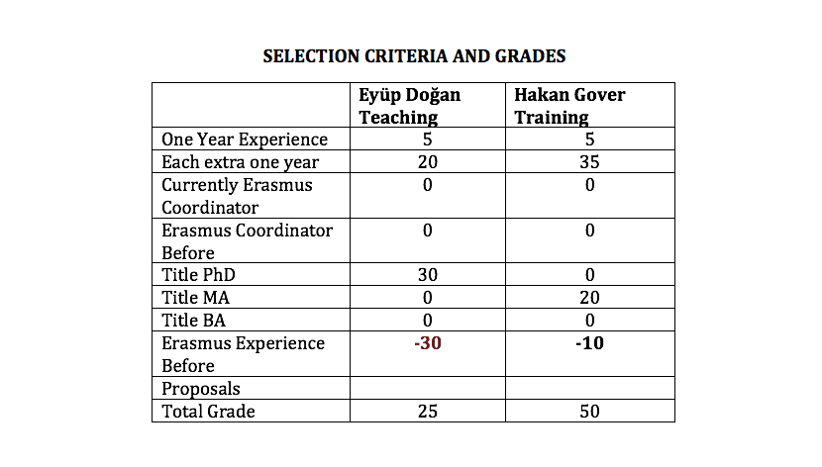
New Applications
2013
2016

Slide 7
Erasmus@AGU 2019-2021
Criteria for staff mobility:
At least one year of work experience at AGU: + 5 points
For each extra year of work experience at AGU: + 5 points
Currently, Erasmus Department Coordinator/Assistant: +10 points
Previous Erasmus Department Coordinator/Assistant: + 5 points
First time Erasmus applicant: +30 points
Academic personnel of Faculties/Schools with Ph.D. Titles: +30 points
Support academic personnel of Faculties/Schools with M.Sc./M.A Titles: +20 points
Support academic personnel of Faculties/Schools with B.Sc./B.A Titles: +10 points
2013
2016

Slide 8
Erasmus@AGU 2019-2021
Criteria for staff mobility:
Language Level 1 : + 40 points for KPDS/YDS .GE. 90, TOEFL IBT .GE. 108
Language Level 2 : + 30 points for KPDS/YDS .GE. 80, TOEFL IBT .GE. 96
Language Level 3 : + 20 points for KPDS/YDS .GE. 70, TOEFL IBT .GE. 84
Language Level 4 : + 10 points for KPDS/YDS .GE. 60, TOEFL IBT .GE. 72
Here .GE. stands for “Greater than or Equal to”. One can get a Language Point from only one of the Language Levels.
For presentation proposals that introduces the research activities, their budgets and the project based RA scholarships at AGU: +10 points
For presentation proposals that promotes the joint research collaborations between the two institutions: +10 points
For presentation proposals that promotes graduate studies at AGU for candidate grad students: +10 points
For presentation proposals that promotes academic exchange activities between the two institutions: +10 points
For presentation proposals that promotes undergrad and grad student exchange activities between the two institutions: +10 points
2013
2016

Slide 9
Erasmus@AGU 2019-2021
Erasmus and Exchange Call: In December
Exam date: ?
Minimum passing score for the English Proficiency Exam?
17 study mobility
30 internship mobility
UNTIL 2021
Quota distribution between the departments?
2013
2016

Slide 10
What’s next?
Next Call
Next Committee Meeting
Info Days
Departmental Info Days
KA 107 (International Credit Mobility
Strategic Partnership
Mevlana Exchange Program
KA 103
Erasmus Calendar
2013
2016

Slide 11
Thank you for your participation!
2013
2016

